Slide 1
Mathematical Induction And Recursive Function
Session 02
Henry Lucky, S.Kom. M.Kom.

Slide 2
Outline Materials
Session 02
Mathematics induction
Recursive function

Slide 3
Learning outcomes
02
LO 1: Explain fundamental concept of analysis algorithms
LO 2: Apply algorithm techniques and methods
LO 3: Solve a problem using specific algorithm.
LO 4: Compare several algorithm design methods

Slide 4
Mathematical induction
summation Formulas and properties
Before we dive into mathematical induction, there are several important summation formulas and properties that you need to know:
Linearity
Arithmetic series
Sums of square and cubes
Geometric series
Harmonic series
Integrating and differentiating series
Telescopic series
Reindexing summations
Products

Slide 5

Mathematical induction
summation Formulas and properties
Linearity:
For any real number c and any finite sequences a1, a2, …, an and b1, b2, …, bn,
$$\sum_{k=1}^{n}{\left(ca_{k}+b_{k}\right)=c\sum_{k=1}^{n}{a_{k}}+\sum_{k=1}^{n}{b_{k}}}$$
The linearity property also applies to infinite convergent series.

Slide 6

Mathematical induction
summation Formulas and properties
Arithmetic series:
The summation
$$\sum_{k=1}^{n}{k}=1+2+…+n$$
is an arithmetic series and has the value
$$\sum_{k=1}^{n}{k}=\frac{n(n+1)}{2}$$

Slide 7
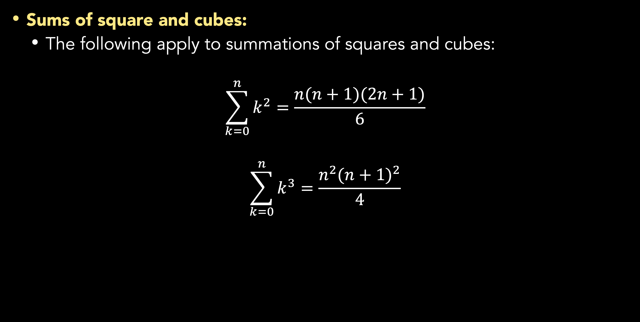
Mathematical induction
summation Formulas and properties
Sums of square and cubes:
The following apply to summations of squares and cubes:
$$\sum_{k=0}^{n}{k^{2}}=\frac{n(n+1)(2n+1)}{6}$$
$$\sum_{k=0}^{n}{k^{3}}=\frac{n^{2}{(n+1)}^{2}}{4}$$

Slide 8
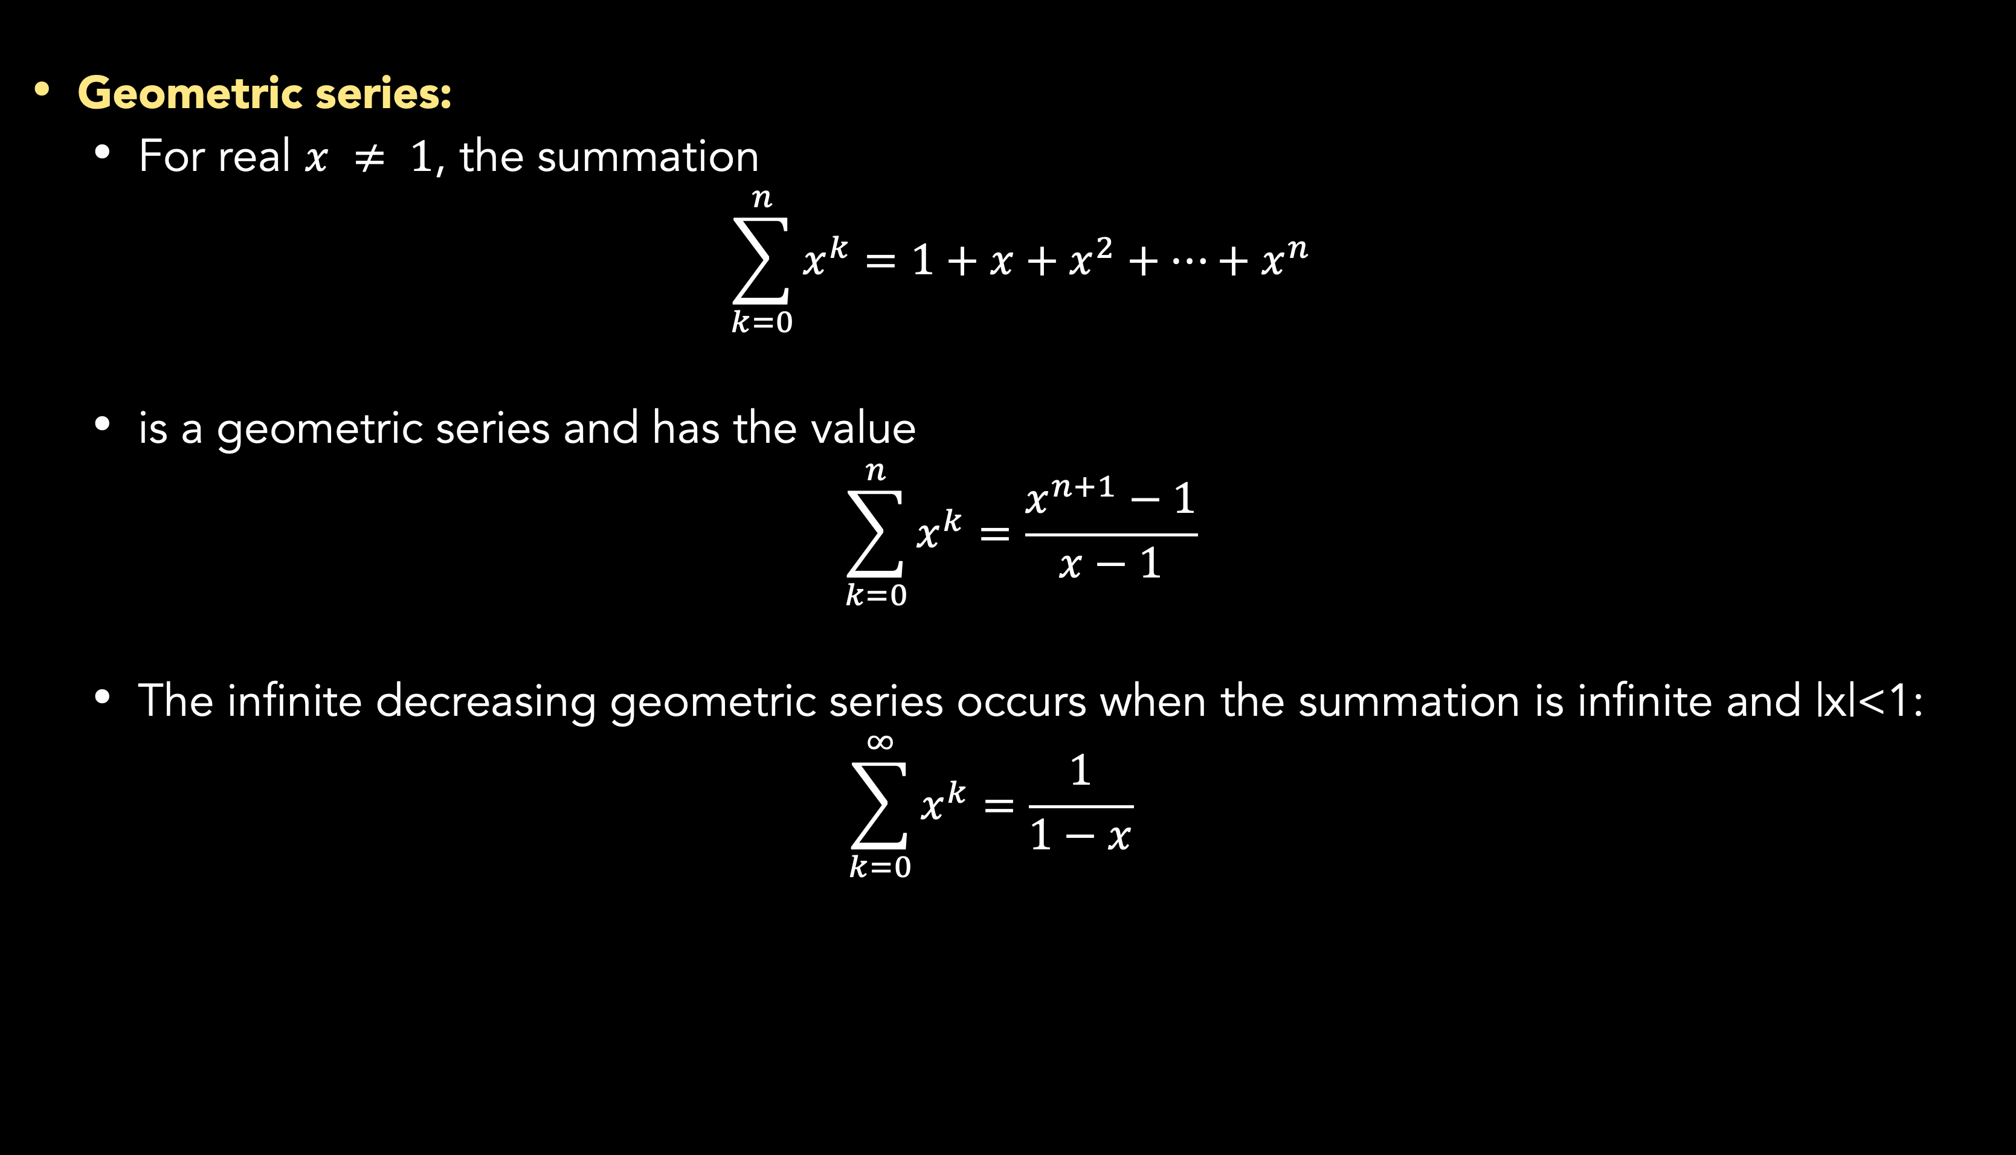
Mathematical induction
summation Formulas and properties
Geometric series:
For real $x ≠ 1$, the summation
$$\sum_{k=0}^{n}{x^{k}}=1+x+x^{2}+…+x^{n}$$
is a geometric series and has the value
$$\sum_{k=0}^{n}{x^{k}}=\frac{x^{n+1}−1}{x−1}$$
The infinite decreasing geometric series occurs when the summation is infinite and |x|<1:
$$\sum_{k=0}^{∞}{x^{k}}=\frac{1}{1−x}$$

Slide 9

Mathematical induction
summation Formulas and properties
Harmonic series:
For positive integers n, the nth harmonic number is
$$H_{n}=1+\frac{1}{2}+\frac{1}{3}+\frac{1}{4}+…+\frac{1}{n}=\sum_{k=1}^{n}{\frac{1}{k}}$$
$$\ln\left(n+1\right)≤H_{n}≤\ln{n}+1$$

Slide 10

Mathematical induction
summation Formulas and properties
Integrating and differentiating series
Integrating or differentiating the formulas yields additional formulas.
For example, differentiating both sides of the infinite geometric series and multiplying by x gives
$$\sum_{k=0}^{∞}{{kx}^{k}}=\frac{x}{{(1−x)}^{2}} for \left|x\right|<1$$

Slide 11

Mathematical induction
summation Formulas and properties
Telescopic series
For any sequences a0, a1, …, an,
$$\sum_{k=1}^{n}{(a_{k}−a_{k−1})}=a_{n}−a_{0}$$
since each of the terms a1, a2,…, an-1is added in exactly once and subtracted out exactly once. Similarly,
$$\sum_{k=0}^{n−1}{(a_{k}−a_{k−1})}=a_{0}−a_{n}$$

Slide 12
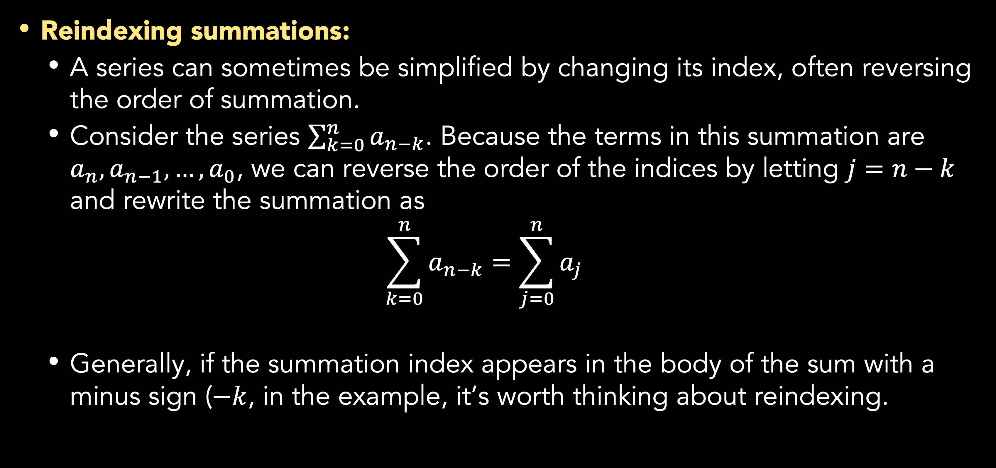
Mathematical induction
summation Formulas and properties
Reindexing summations:
A series can sometimes be simplified by changing its index, often reversing the order of summation.
Consider the series $\sum_{k=0}^{n}{a_{n−k}}$. Because the terms in this summation are $a_{n},a_{n−1}, …,a_{0}$, we can reverse the order of the indices by letting $j=n−k$ and rewrite the summation as
$$\sum_{k=0}^{n}{a_{n−k}}=\sum_{j=0}^{n}{a_{j}}$$
Generally, if the summation index appears in the body of the sum with a minus sign ($−k$, in the example, it’s worth thinking about reindexing.

Slide 13

Mathematical induction
summation Formulas and properties
Product:
The finite product $a_{1}a_{2}…a_{n}$, can be expressed as
$$\prod_{k=1}^{n}{a_{k}}$$
If n = 0, the value of the product is defined to be 1. You can convert the formula with a product to a formula with a summation by using the identity
$$\lg\left(\prod_{k=1}^{n}{a_{k}}\right)=\sum_{k=1}^{n}{\lg{a_{k}}}$$

Slide 14
Mathematical induction
Other Mathematical formulas
Some refreshing…

Slide 15
MATHEMATICAL INDUCTION
Definition
Mathematic induction is a method to prove an equation is true for all unsigned integer (positive integer number)
Induction steps:
Prove P(1) is true.
Prove if P(n) is true; then P(n+1) is also true.
Conclusion: ∀n P(n) are true

Slide 16
Mathematical induction
Example
Prove that the number of first n natural numbers is n (n +1) / 2
If n = 1 then 1 = 1(1+1)/2 → proven
If n = k must be proven that the statement is also true for n = k +1

Slide 17
Mathematical induction
Example
Assume is true for n = k
Add (k+1) on both sides

Slide 18
Recursive function
Module
Several lines of algorithm that work for certain function can be grouped in a module.
Module is very useful if the lines of algorithm are called/run by number of processes.
Term of module in programming language :
Procedure
Sub
Function
A module called by:
Main program
Other modules
The module itself
Communication with the caller dialing module:
Using parameter
By value
By reference/location
A module that called itself called as recursive technique.

Slide 19
Recursive function
Recursive algorithm
Recursive is an algorithm that executes itself.
It divides a complex problem to smaller problems:
Solve each smaller problem
Become solution of the main problem
It is an effective algorithm if planned very well.

Slide 20
Recursive function
Example
Factorial Problem: 0! = 1; 1! = 1; 2! = 2 x 1; 3! = 3 x 2 x 1; 4! = 4 x 3 x 2 x 1; 5! = 5 x 4 x 3 x 2 x 1;
Calculating Factorial using iteration algorithm:
Calculating Factorial using recursive
1 module Factorial (N)
2 r=1
3 for i=1 to N do
4 r=r*i
5 end for
6 result=r
7 end module
1 module factorial (N)
2 if N<=1 then
3 result=1
4 else
5 result=N*Faktorial(N-1)
6 end if
7 end module

Slide 21
Recursive function
Disadvantages of recursive
Memory allocation
Finite condition (avoid infinite loop)
Debugging technique
Understanding of scope variable

Slide 22
Summary
Mathematic induction is a method to prove an equation is true for all unsigned integer (positive integer number)
Recursive is an algorithm that executes itself and can be efficient if planned well.

Slide 23
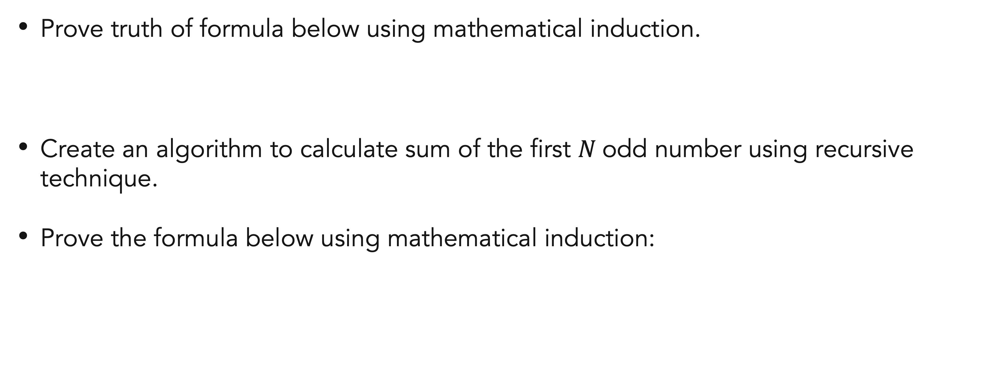
Exercises
Mathematical induction
Prove truth of formula below using mathematical induction.
Create an algorithm to calculate sum of the first $N$odd number using recursive technique.
Prove the formula below using mathematical induction:

Slide 24
References
S. Sridhar. 2014. Design and Analysis of Algorithms, 1/e. Oxford University Press. India. Chapter 4
Thomas H. Cormen. (2022). Introduction to algorithms: Fourth edition. The MIT Press. Appendix: Mathematical Background.
Induction and Recursion
http://www.cs.cmu.edu/~rwh/introsml/techniques/indrec.htm

Slide 25
Thank you
Mathematical Induction And Recursive Function
September, 2023

